Slide 1
Azure Identity for Apps Hackathon
[Country], [Date]

Slide 2
Hackathon Format
Challenge-based hackathon format
Challenges describe high-level tasks and goals to be accomplished
Challenges are not step-by-step labs.
By having to “figure it out”, attendee knowledge retention is greater
Attendees work in squads of 3 to 5 people to solve the challenges
Attendees “learn from” and “share with” each other.
Coaches provide technical guidance, but not answers to the squads
Coaches may provide lectures & demos to setup challenges & review solutions

Slide 3
Purpose
The Identity for Apps hackathon will provide a deep dive experience targeted for developers by integrating Azure AD Identity solutions into applications.
Hackathon is a collaborative learning experience, designed as a set of challenges to practice your technical skills.
By participating in this hackathon, you will be able to understand the capabilities of Azure AD B2B and Azure AD B2C and learn how modern authentication works with Microsoft identity platform.

Slide 4
Coaches Intros!
Each team will have a coach through-out the whole hack.
Use them! But don’t expect them to give you all the answers ;)
Coach Name
Coach role
Coach Name
Coach role
Coach Name
Coach role
Coach Name
Coach role

Slide 5
Introduce yourselves ☺
Name
Role
Expertise on Azure AD
Hackathon Expectations

Slide 6
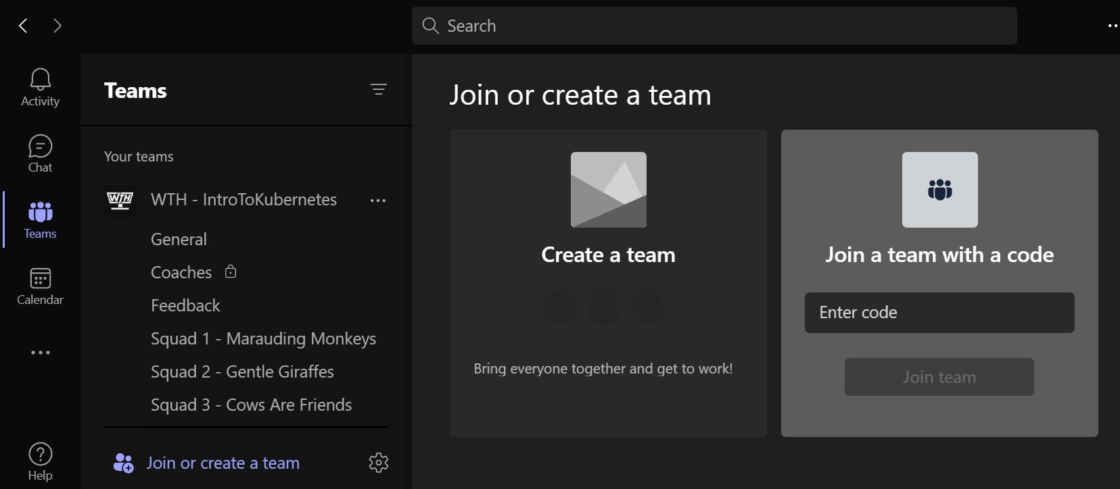
Join the Team with the Code: qdubc37
WIFI: msevent123gl

Slide 7
Wi-Fi Connection Instructions: • Make sure your wireless adapter is set to dynamically obtain an IP address • Connect to the wireless network [Name of Network] • Open a browser and navigate to a web site to be redirected to the Captive Portal • Click on Event Attendee Code and enter the access code: [set code]

Slide 8
Agenda
Day 1
Day 2
Time | Activity
9:00-9:30 | Arrival/Coffee
9:30-09:45 | Opening and Welcome
9:45-11:00 | Team Hacking
11:00-11:15 | Coffee Break
11:15-12:45 | Team Hacking
12:45 -13:30 | Lunch Break
13:30-14:30 | Team Hacking
14:30-14:45 | Coffee Break
14:45-15:55 | Team Hacking
15:55-16:00 | Day 1 Closing
Time | Activity
9:00-9:30 | Arrival/Coffee
9:30-11:00 | Team Hacking
11:00-11:15 | Coffee Break
11:15-12:45 | Team Hacking
12:45 -13:30 | Lunch Break
13:30-14:30 | Team Hacking
14:30-14:45 | Coffee Break
14:45-15:40 | Team Hacking
15:40-16:00 | Q&A, Feedback, End of Hackathon

Slide 9
Day 1 Challenges Overview Azure AD B2B Collaboration
Challenge 0: Prepare Your Environment
Setup your environment and get ready to deploy Identity solutions
Challenge 1: Getting Started
Getting started by configuring your Azure AD tenant
Challenge 2: Add sign-in with Azure AD Identity to an ASP.NET Core web app
Integrate an ASP.NET Core web app sample with Azure AD B2B and get familiar with the identity concepts
Challenge 3: Deploy your Web Application to Azure
Deploy the ASP.NET Core web app sample in Azure as an App Service Web App and get familiar with secutity tokens
Challenge 4: Enable External Identities
Create an external tenant and configure your home tenant by enabling external identities
Challenge 5: Control who can authenticate in your app
Control the users or groups who can authenticate in your app
Challenge 6: Enable Conditional Access Policies and enforce Multifactor Authentication
Enforce Multifactor Authentication by enabling Conditional Access Policies
Challenge 7: Make your application Multi-tenant
Transform your application from Single-tenant to Multi-tenant
https://aka.ms/idhackathon

Slide 10
Day 2 Challenges Overview Azure AD B2C
Challenge 1: Getting Started with Azure AD B2C
Getting started by configuring your Azure AD B2C tenant
Challenge 2: Add Azure AD B2C sign-in, sign-up to an ASP.NET Core web app
Integrate an ASP.NET Core web app sample with Azure AD B2C
Challenge 3: Deploy the web app to Azure
Deploy the ASP.NET Core web app sample in Azure as an App Service Web App
Challenge 4: Login with External Identity Providers
Setting up federation with Google or Facebook and login to your application with third party identity providers
Challenge 5: Branding
Add branding and customize user experience
Challenge 6: Claims Enrichment with API Connectors
Claims enrichment with external API connectors
Challenge 7: Monitoring and Observability
Monitoring your B2C tenant
https://aka.ms/idhackathon

Slide 11
Advanced Challenges
Day 1
Day 2
Optional Challenge 8: Branding your sign-in page
Add branding to your sign-in page
Optional Challenge 9: Login with a Microsoft (outlook.com), Google or Facebook account
Setting up federation with Google or Facebook and login to your application with third party identity providers
Optional Challenge 10: Configure App Roles
Configure and use App roles to control whether a user can sign in to your application
Optional Challenge 8: Identity Experience Framework, get ready for custom policies
Get ready with custom policies by configuring the Trust Framework in your B2C tenant.
Optional Challenge 9: Create Custom Policies
Use custom policies in Sign Up and Sign In user journeys by incorporating dynamic 'Terms of Use' prompt
Optional Challenge 10: Conditional Access and MFA
Implement Multifactor Authentication by enabling Conditional Access Policies

Slide 12
Prerequisites
Your laptop: Win, MacOS or Linux OR a development machine that you have administrator rights.
An active Azure subscription with Global Administrator access to create or modify resources and permissions.
OR
Use the Azure Pass that will be provided to you during the Hackathon.
Visual Studio 2019/2022 or Visual Studio Code
Azure AD Premium P2 trial license
.NET Core 3.1 SDK and .NET 6 SDK
Azure CLI
PowerShell
Git Client
Claim your Azure Pass!
But remember to create a tenant and global admin account first!

Slide 13
Exam vouchers
Here is the Form, through which you can request for the voucher.
It will be approved only to participating persons (they can share it with colleagues withing the company). Gift letter should be signed by the partner through Power Automate process and utilization is traced.
Vouchers are valid to use till Dec 31.

Slide 14
Please, give us feedack ☺
Feedback Form [Add URL]

Slide 15
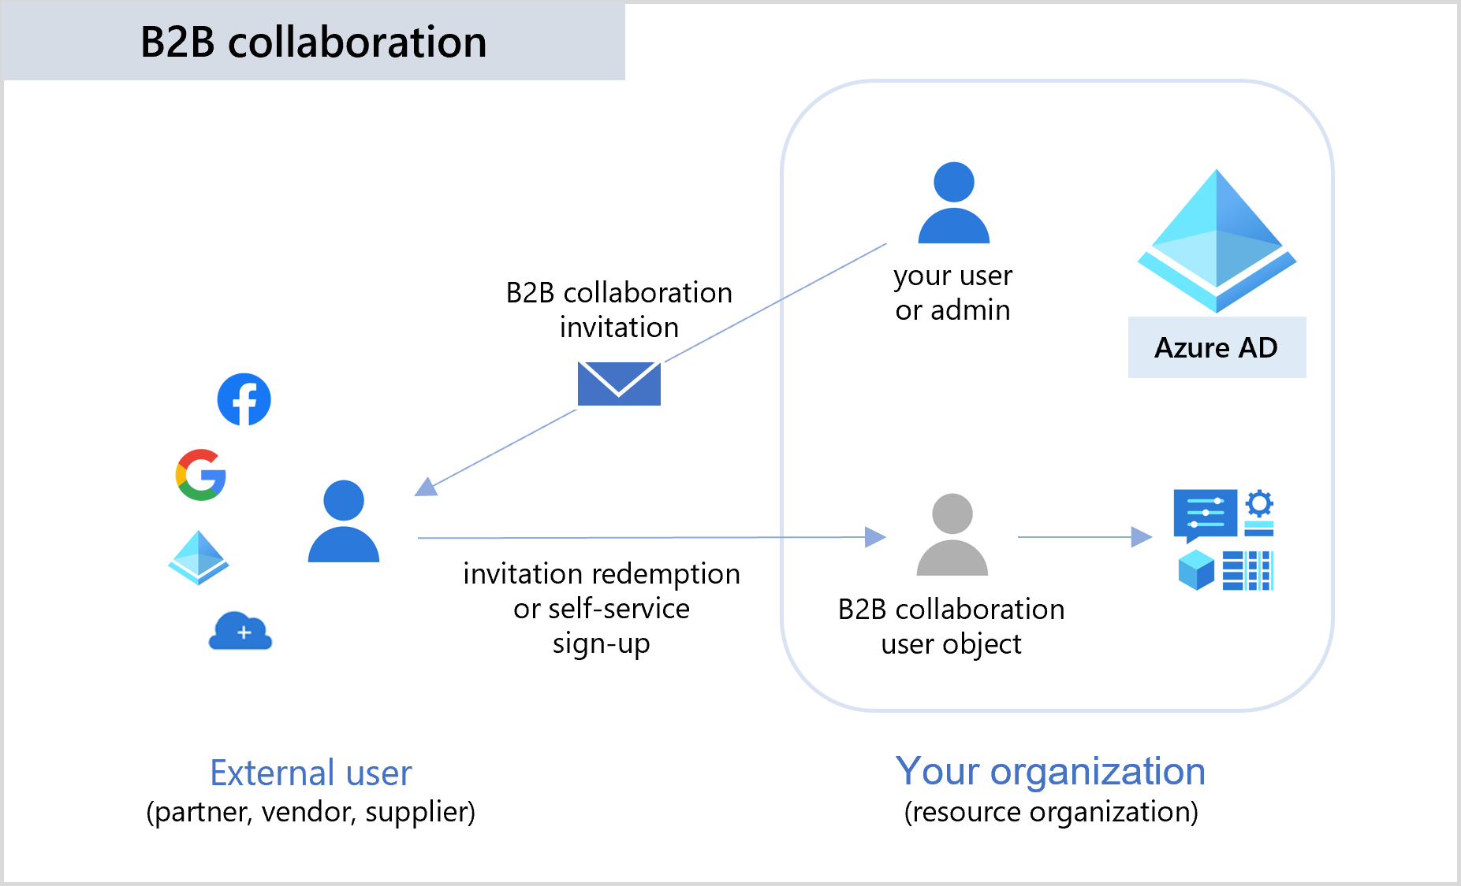
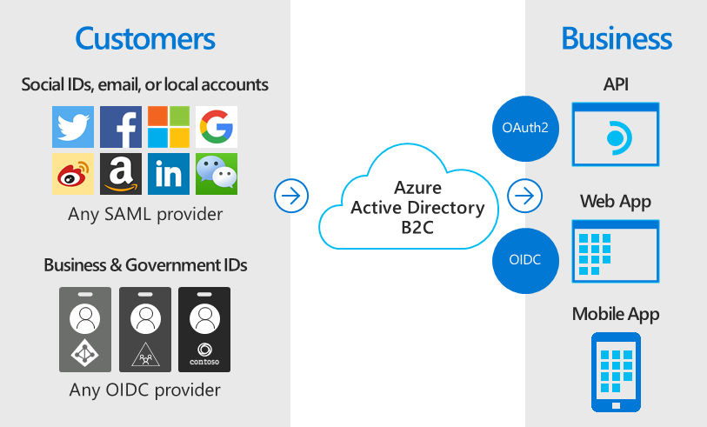
Let’s Start!
Azure AD B2B Collaboration
Azure AD B2C
B2B collaboration overview - Azure AD - Microsoft Entra | Microsoft Learn
Technical and feature overview - Azure Active Directory B2C | Microsoft Learn
You will find the challenges for Day 1 & 2 here: https://aka.ms/idhackathon

